Slide 1
AWS CodeCommit & CodeBuild
Shakif Malek
29th October, 2018

Slide 2
What is CodeCommit?
AWS CodeCommit is a version control service hosted by Amazon Web Services that you can use to privately store and manage assets (such as documents, source code, and binary files) in the cloud.

Slide 3
Benefits and features
Fully managed
AWS CodeCommit eliminates the need to host, maintain, back up, and scale your own source control servers. The service automatically scales to meet the growing needs of your project.
High availability
AWS CodeCommit has a highly scalable, redundant, and durable architecture. The service is designed to keep your repositories highly available and accessible.
Secure
AWS CodeCommit automatically encrypts your files in transit and at rest. CodeCommit is integrated with AWS Identity and Access Management (IAM) allowing you to assign user-specific permissions to your repositories.
Store Anything
AWS CodeCommit allows you to store any type of file, and there are no repository size limits. This allows you to store and version application assets, like images and libraries, along with your code.

Slide 4
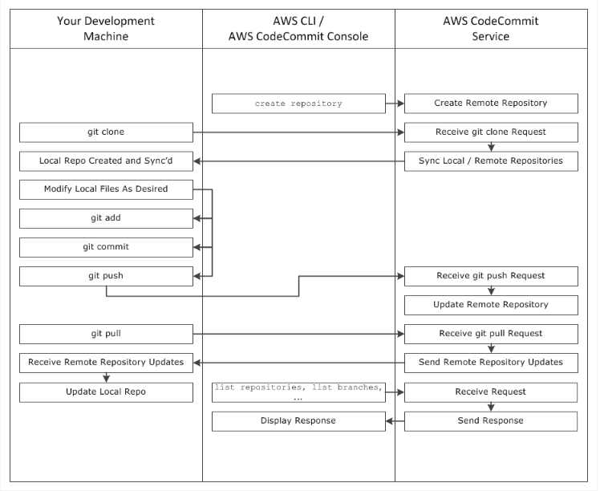
How Does AWS CodeCommit Work?

Slide 5
So, CodeCommit is alternative to S3?
NO!!!!
AWS CodeCommit is designed for team software development. It manages batches of changes across multiple files, which can occur in parallel with changes made by other developers. Amazon S3 versioning supports the recovery of past versions of files, but it's not focused on collaborative file tracking features that software development teams need.

Slide 6
What is CodeBuild?
AWS CodeBuild is a fully managed build service in the cloud. AWS CodeBuild compiles your source code, runs unit tests, and produces artifacts that are ready to deploy. AWS CodeBuild eliminates the need to provision, manage, and scale your own build servers. It provides prepackaged build environments for the most popular programming languages and build tools such as Apache Maven, Gradle, and more. You can also customize build environments in AWS CodeBuild to use your own build tools. AWS CodeBuild scales automatically to meet peak build requests

Slide 7
Benefits and features
Fully managed build service
AWS CodeBuild scales up and down automatically to meet your build volume. It immediately processes each build you submit and can run separate builds concurrently, which means your builds are not left waiting in a queue.
Pay as you go
You can bring your own build tools and programming runtimes to use with AWS CodeBuild by creating customized build environments in addition to the prepackaged build tools and runtimes supported by CodeBuild.
Elastic scaling
With AWS CodeBuild, you are charged based on the number of minutes it takes to complete your build. This means you no longer have to worry about paying for idle build server capacity.
Extensible
AWS CodeBuild belongs to a family of AWS Code Services which you can use to create complete, automated software release workflows for continuous integration and delivery (CI/CD). You can also integrate CodeBuild into your existing CI/CD workflow.

Slide 8
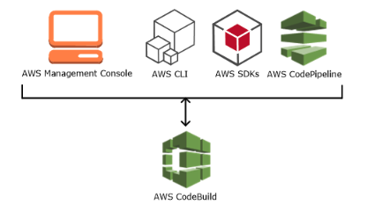
How to Run AWS CodeBuild

Slide 9
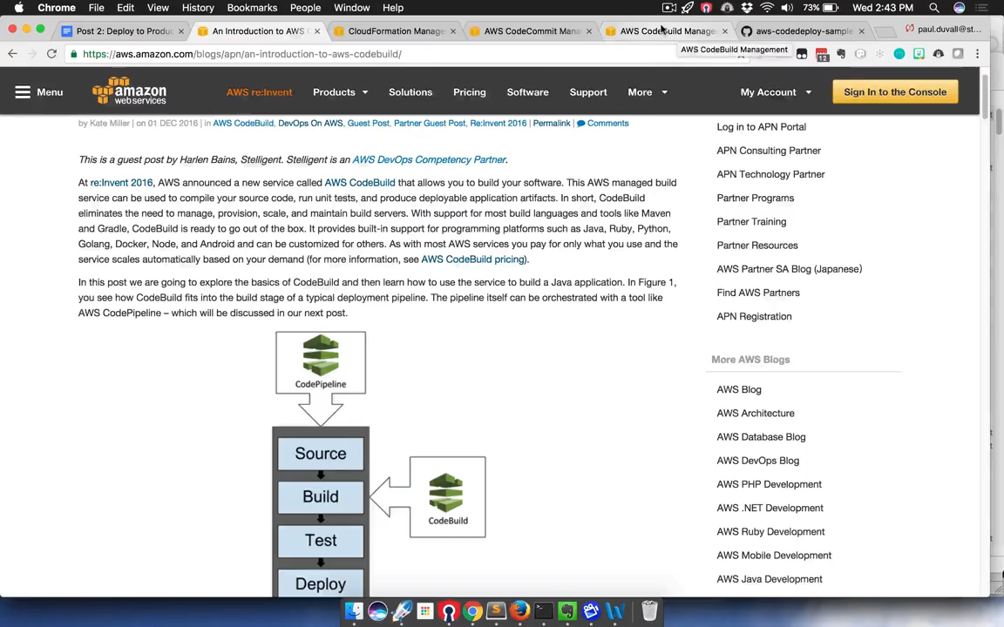

Slide 10
References
https://docs.aws.amazon.com/codecommit/latest/userguide/welcome.html
https://us-east-2.console.aws.amazon.com/codesuite/codebuild/home?region=us-east-2
https://docs.aws.amazon.com/codebuild/latest/userguide/welcome.html
https://www.youtube.com/watch?v=8YLcNczTZkE&list=PLSHbcVrx0dWvhaHOU9v2qnKftGkz2SUFq

